Slide 1
Введение в нейросети
Part 2
tg: @naconov, @zamyrailov
GitHub: NasonovIvan, maykitbo

Slide 2
Recap previous lecture
Deep Learning intro
MNIST digits
Hidden layers intuition
Non-linear activation
Weights matrix
Gradient descent
Weights update
3Blue1Brown

Slide 3
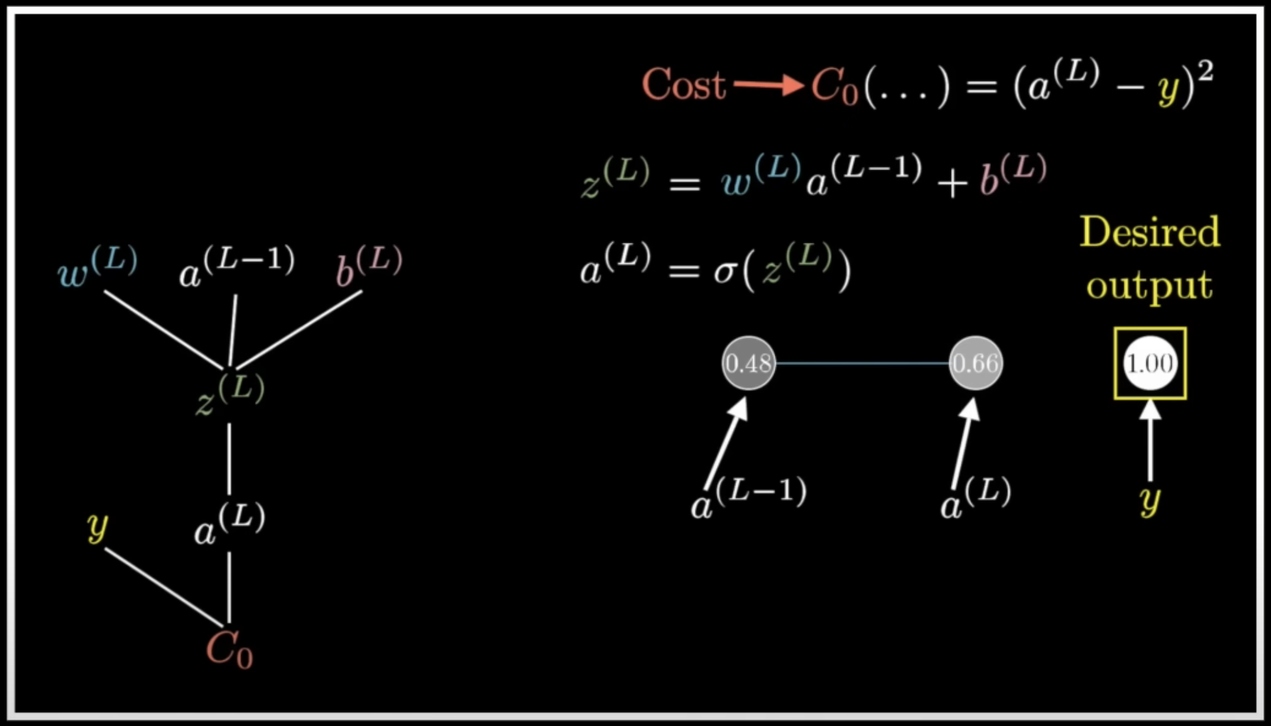
Derivatives in computational graphs
3Blue1Brown

Slide 4
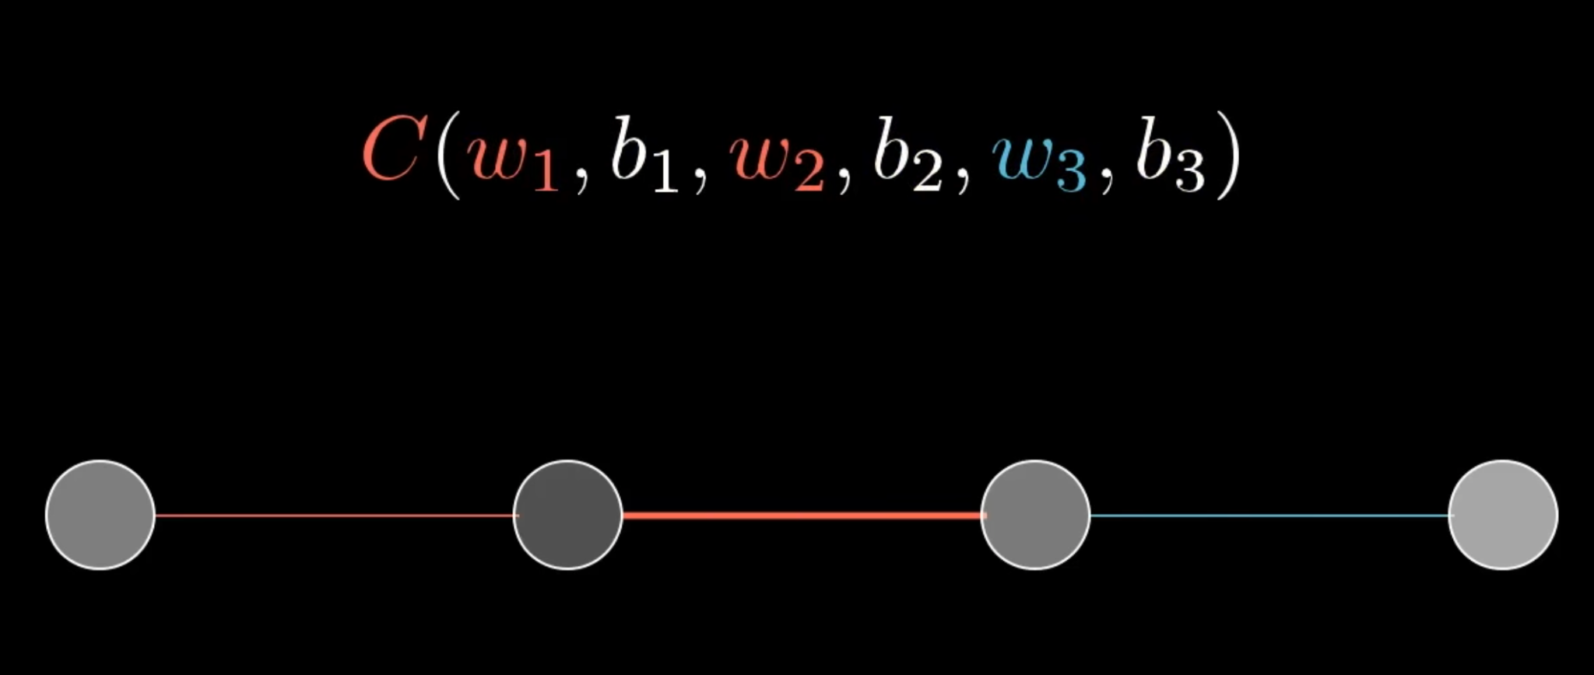
3Blue1Brown

Slide 5
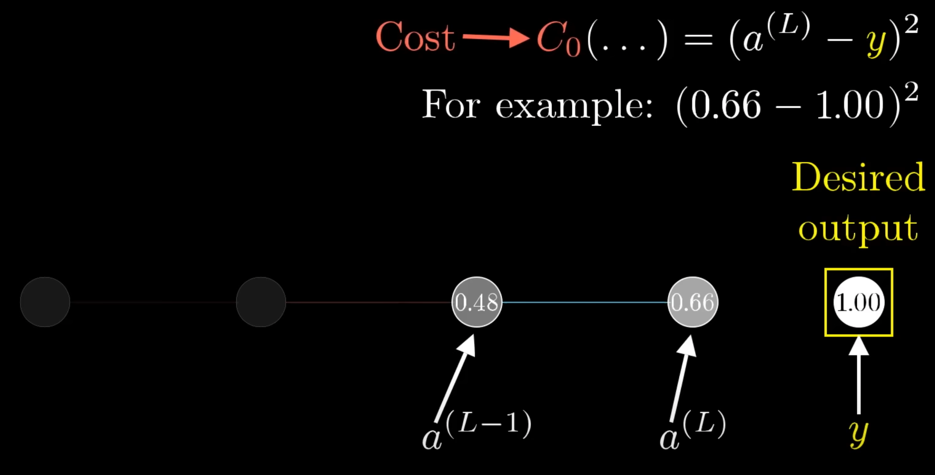
3Blue1Brown

Slide 6
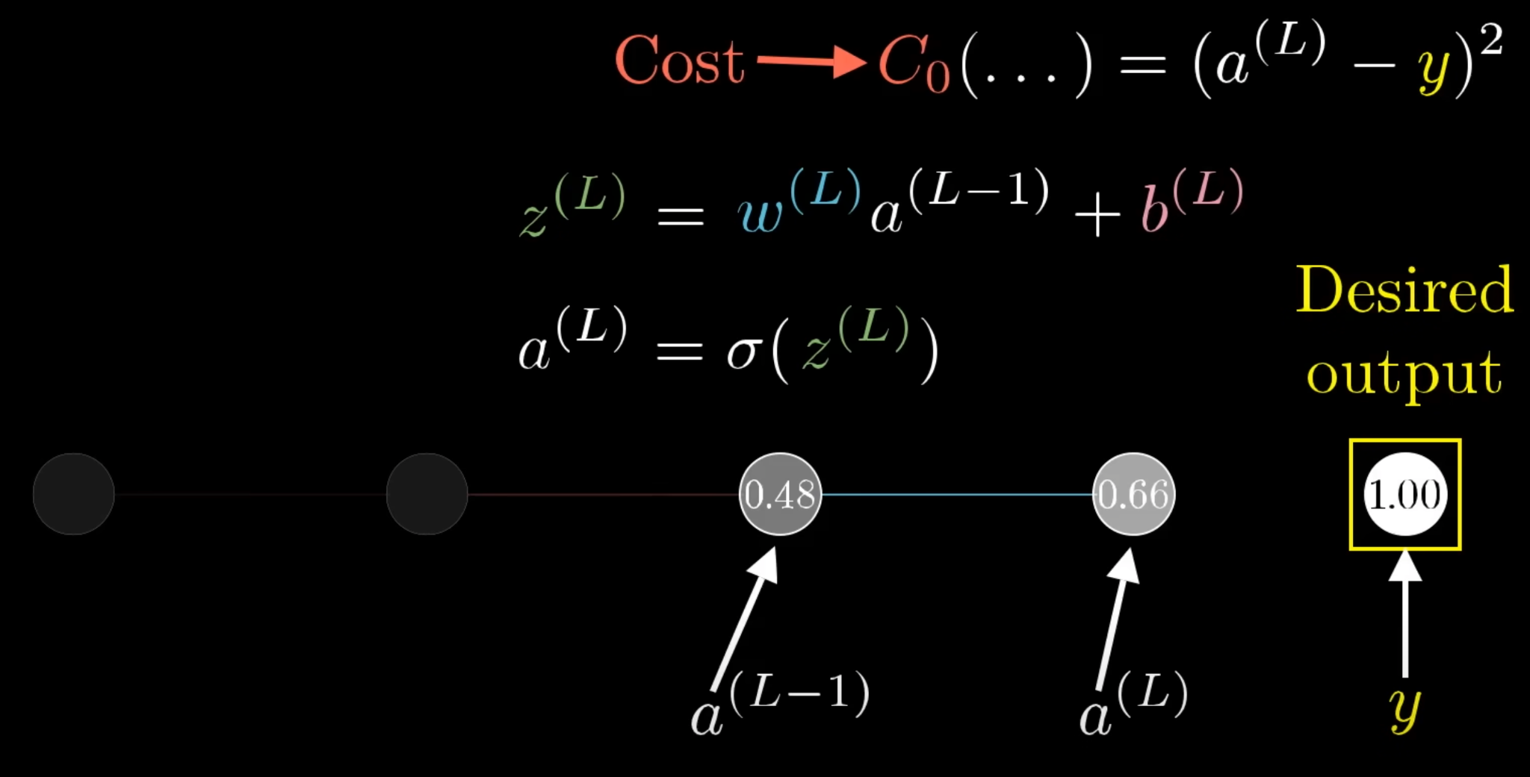
3Blue1Brown

Slide 7
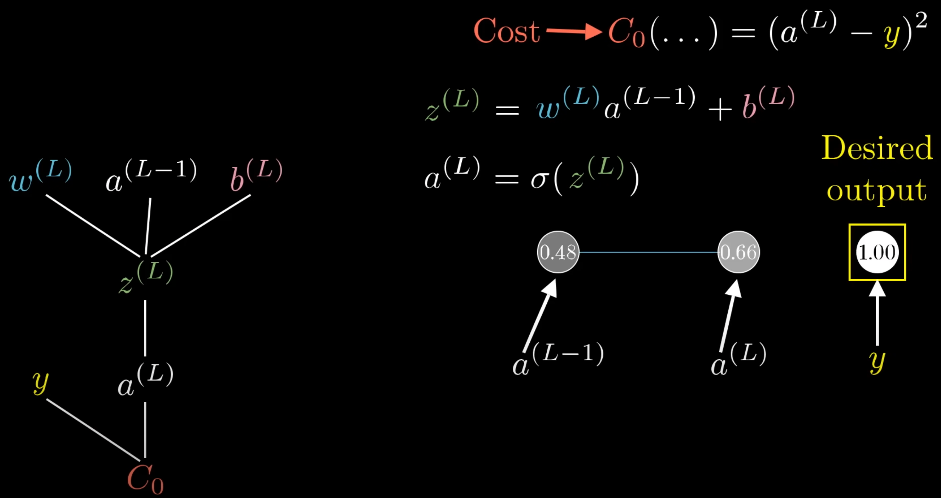
3Blue1Brown

Slide 8
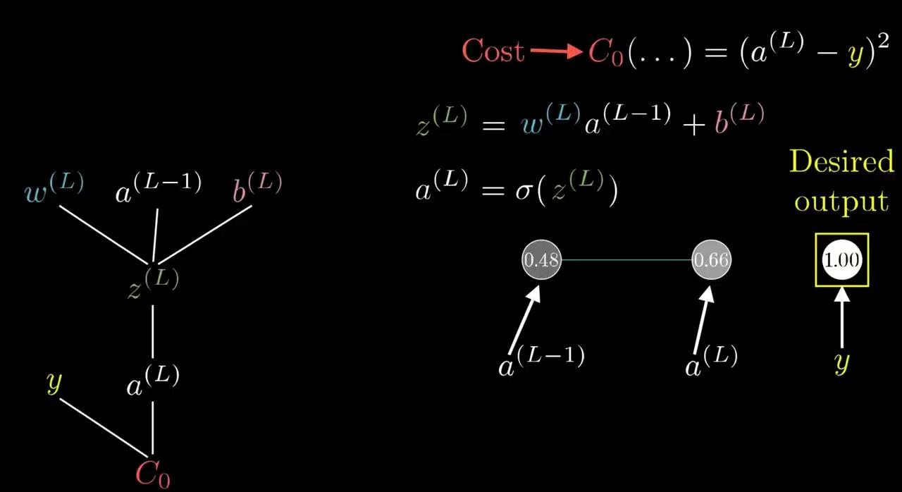
3Blue1Brown

Slide 9
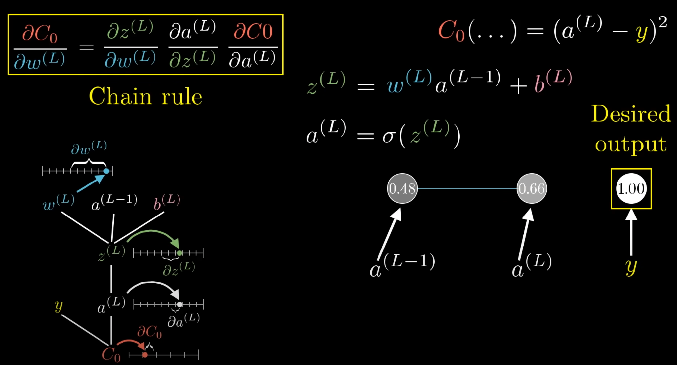
3Blue1Brown

Slide 10
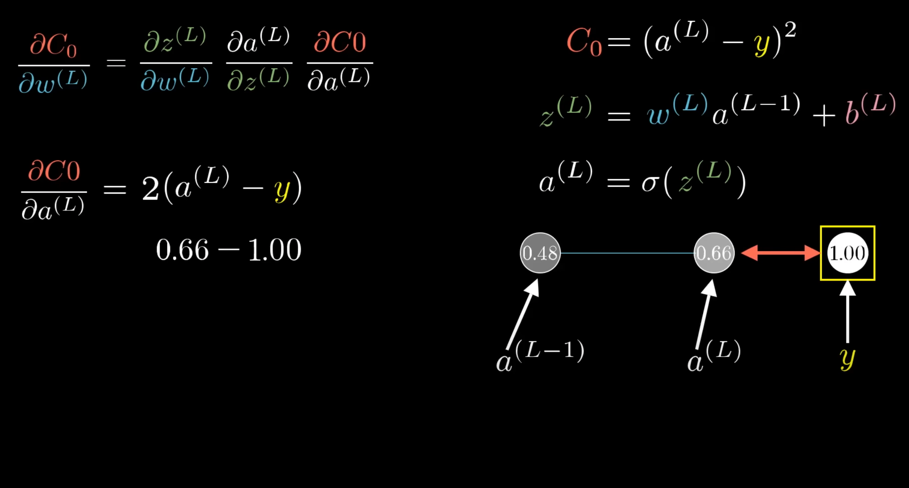
3Blue1Brown

Slide 11
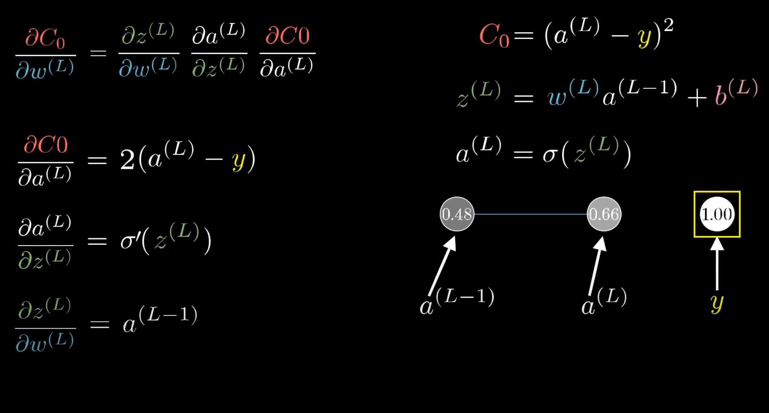
3Blue1Brown

Slide 12
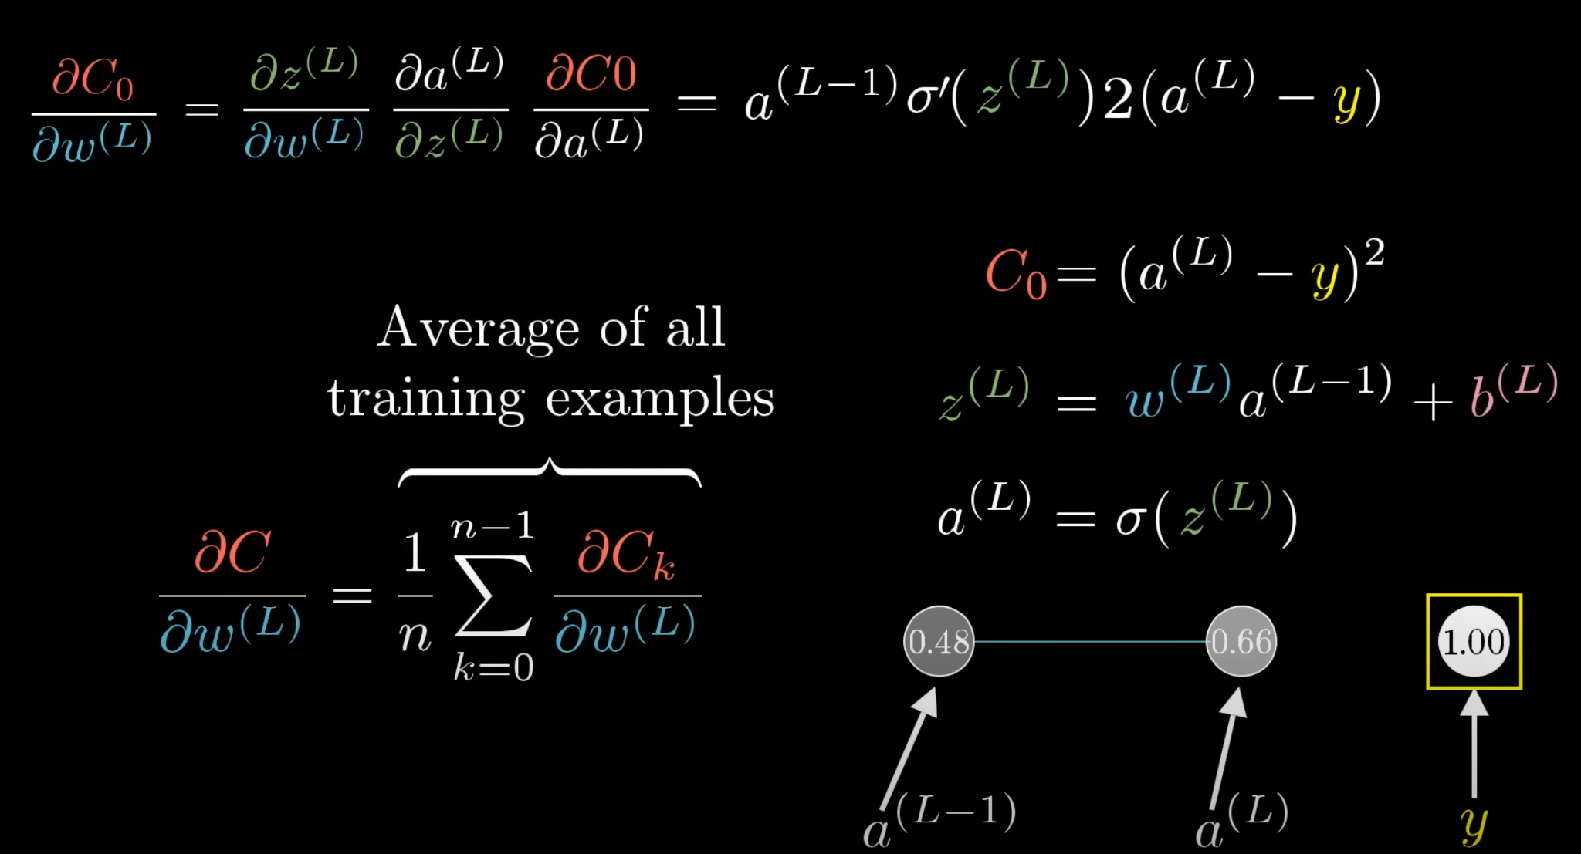
3Blue1Brown

Slide 13
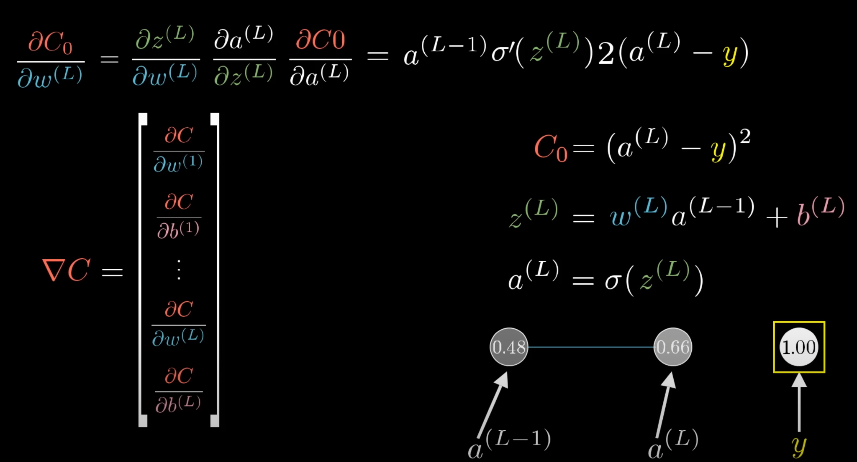
3Blue1Brown

Slide 14
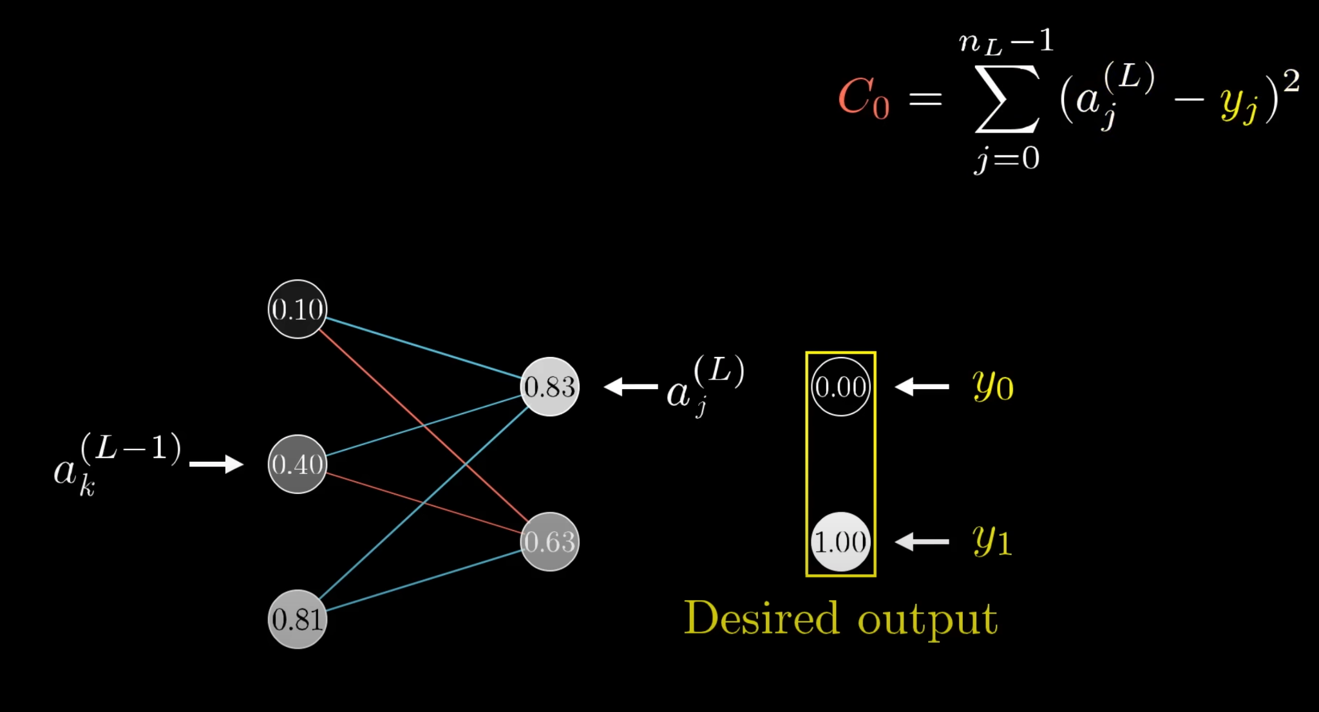
3Blue1Brown

Slide 15
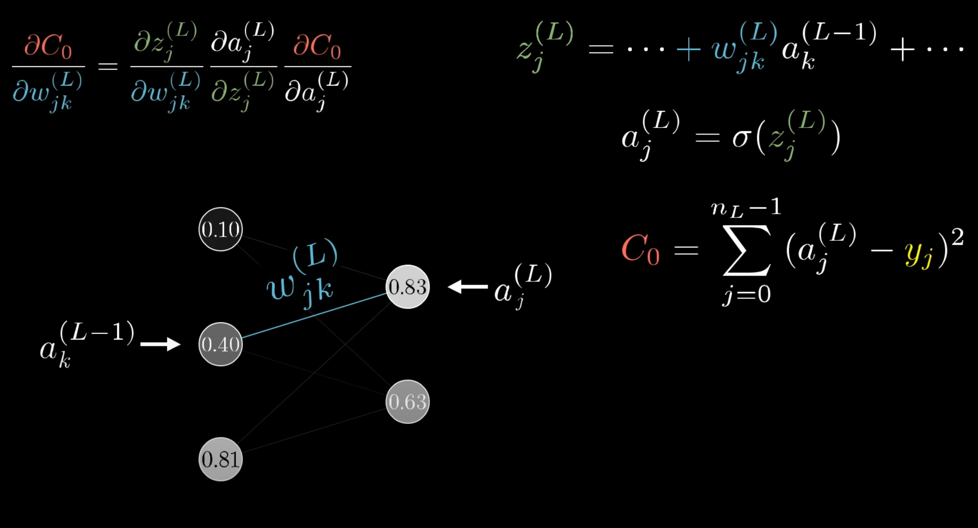
3Blue1Brown

Slide 16
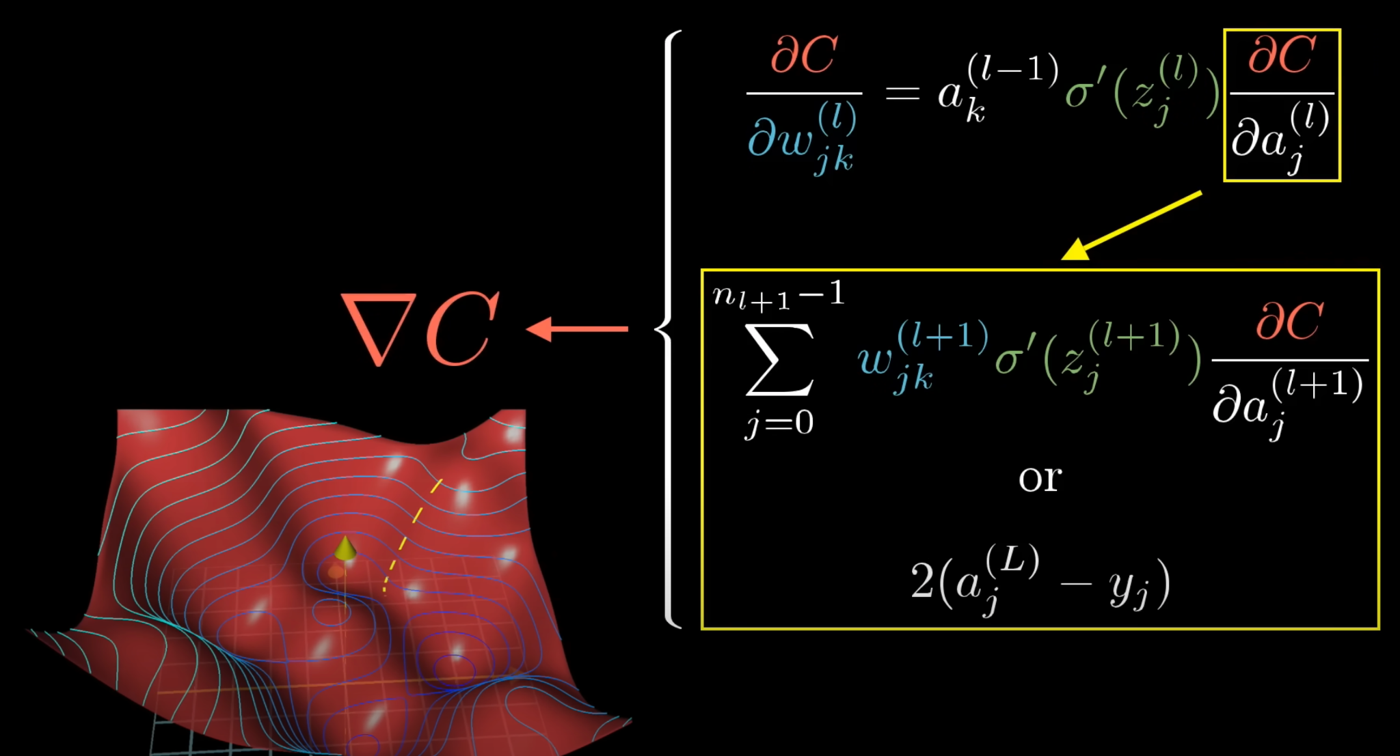
3Blue1Brown

Slide 17
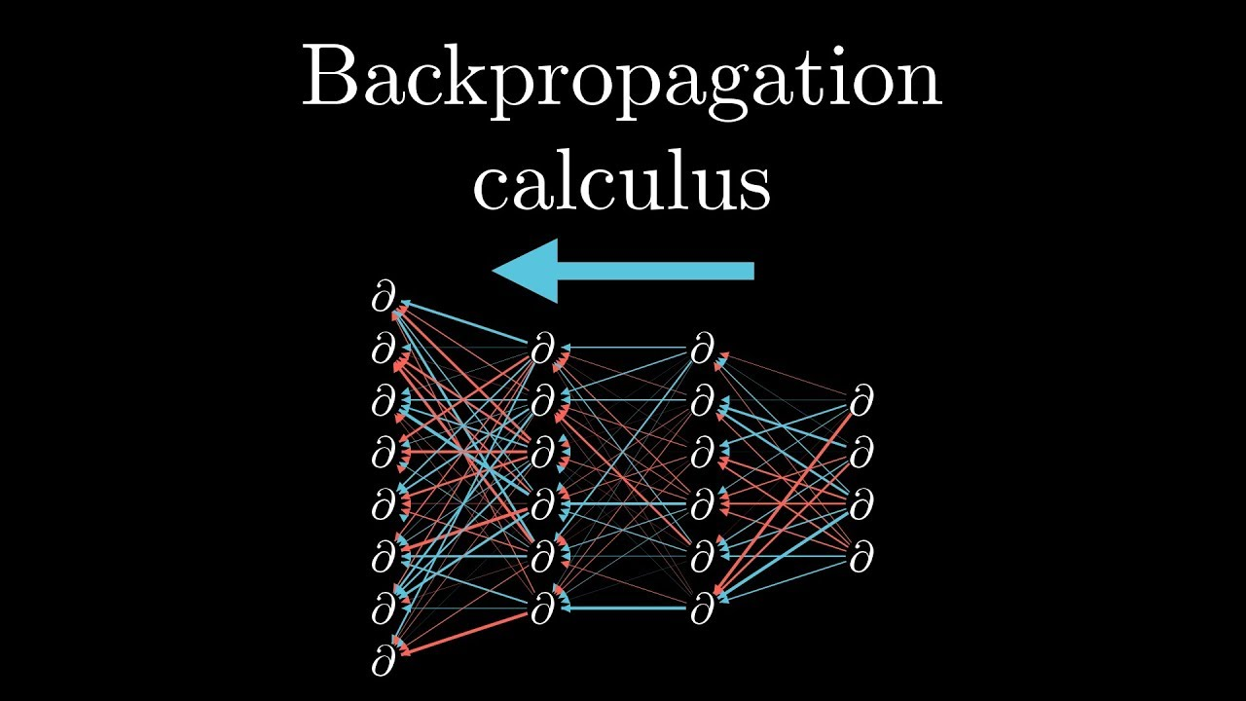
3Blue1Brown

Slide 18
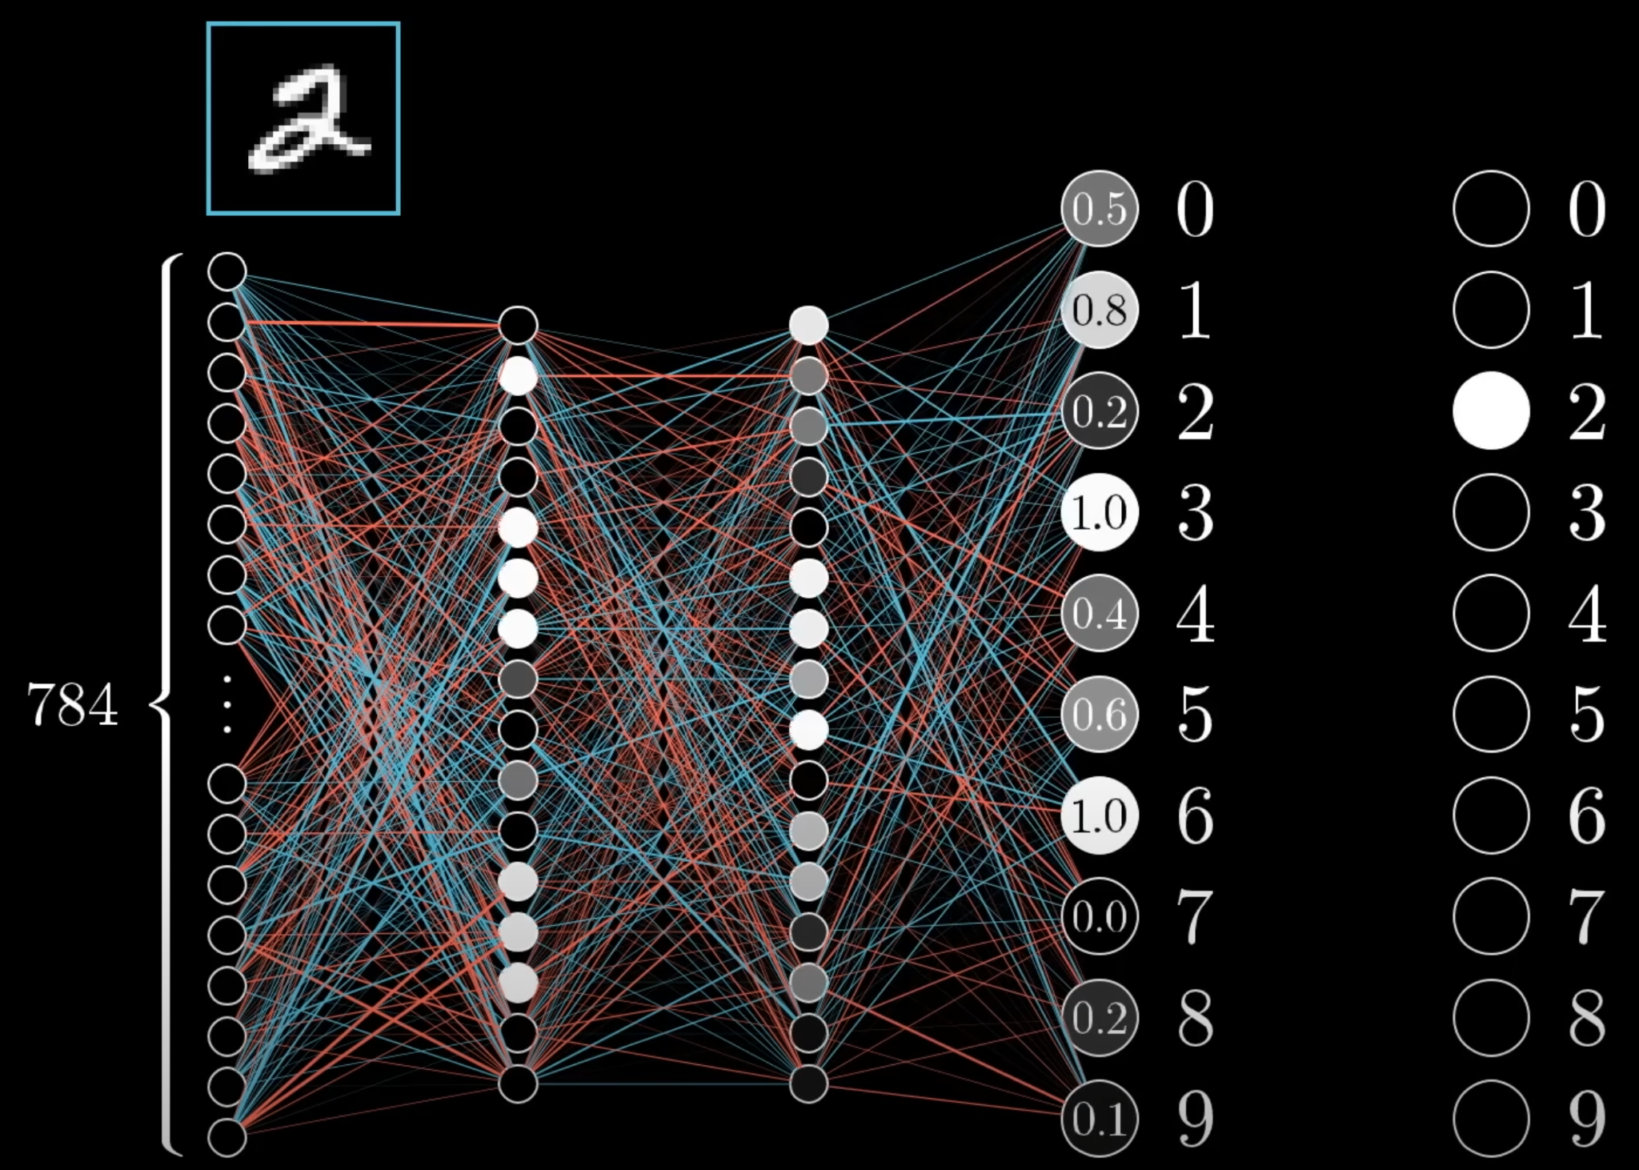
3Blue1Brown

Slide 19
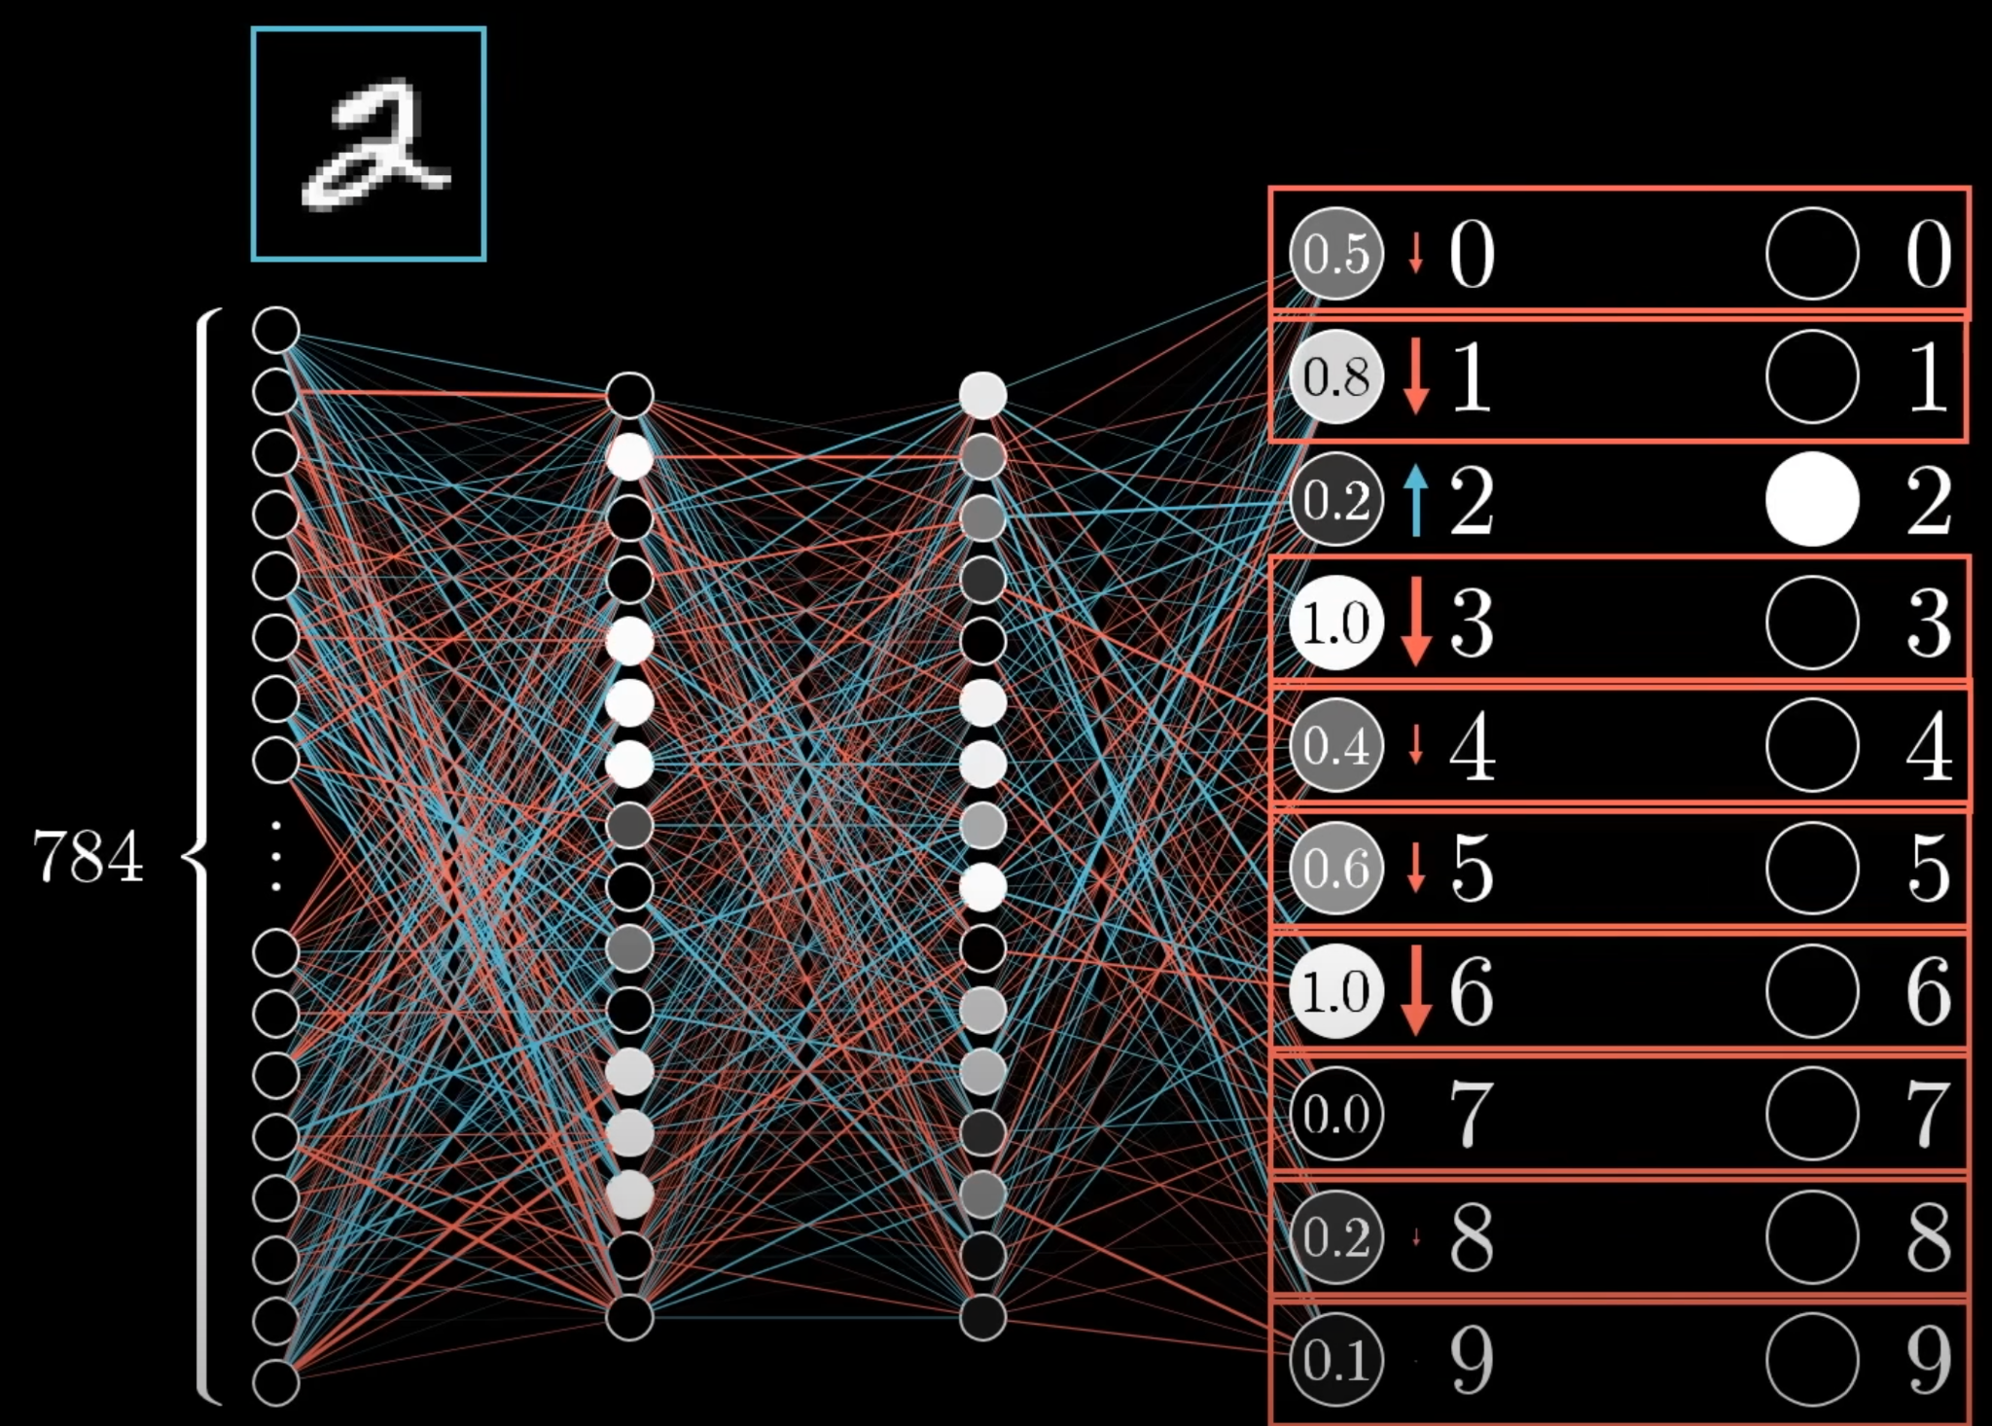
3Blue1Brown

Slide 20
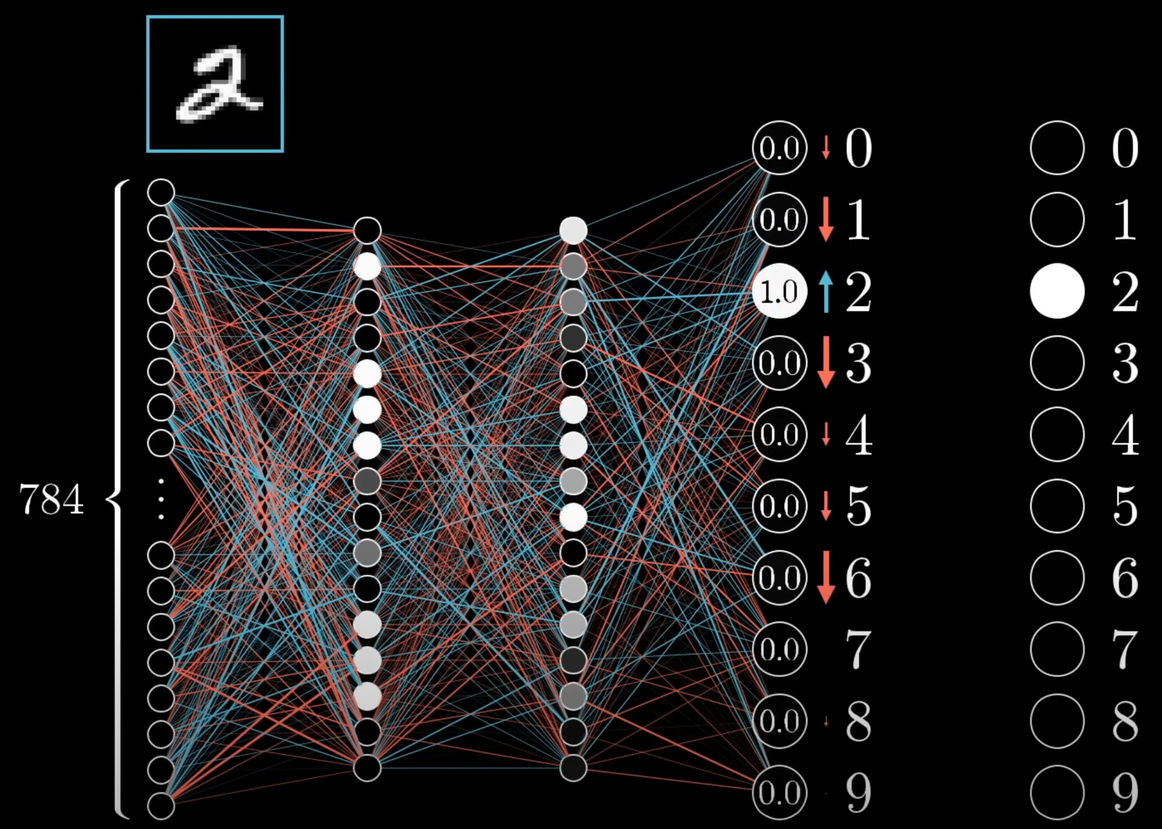
3Blue1Brown

Slide 21
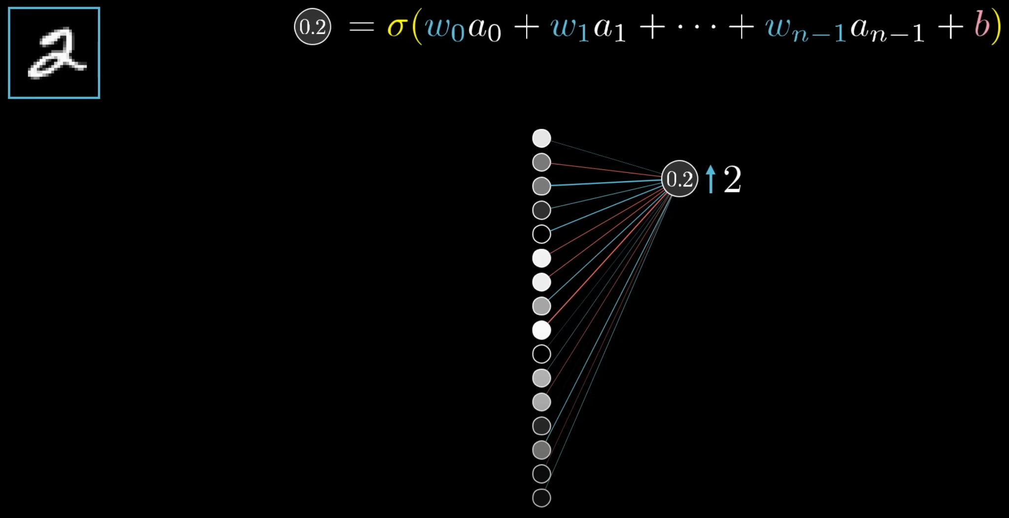
3Blue1Brown

Slide 22
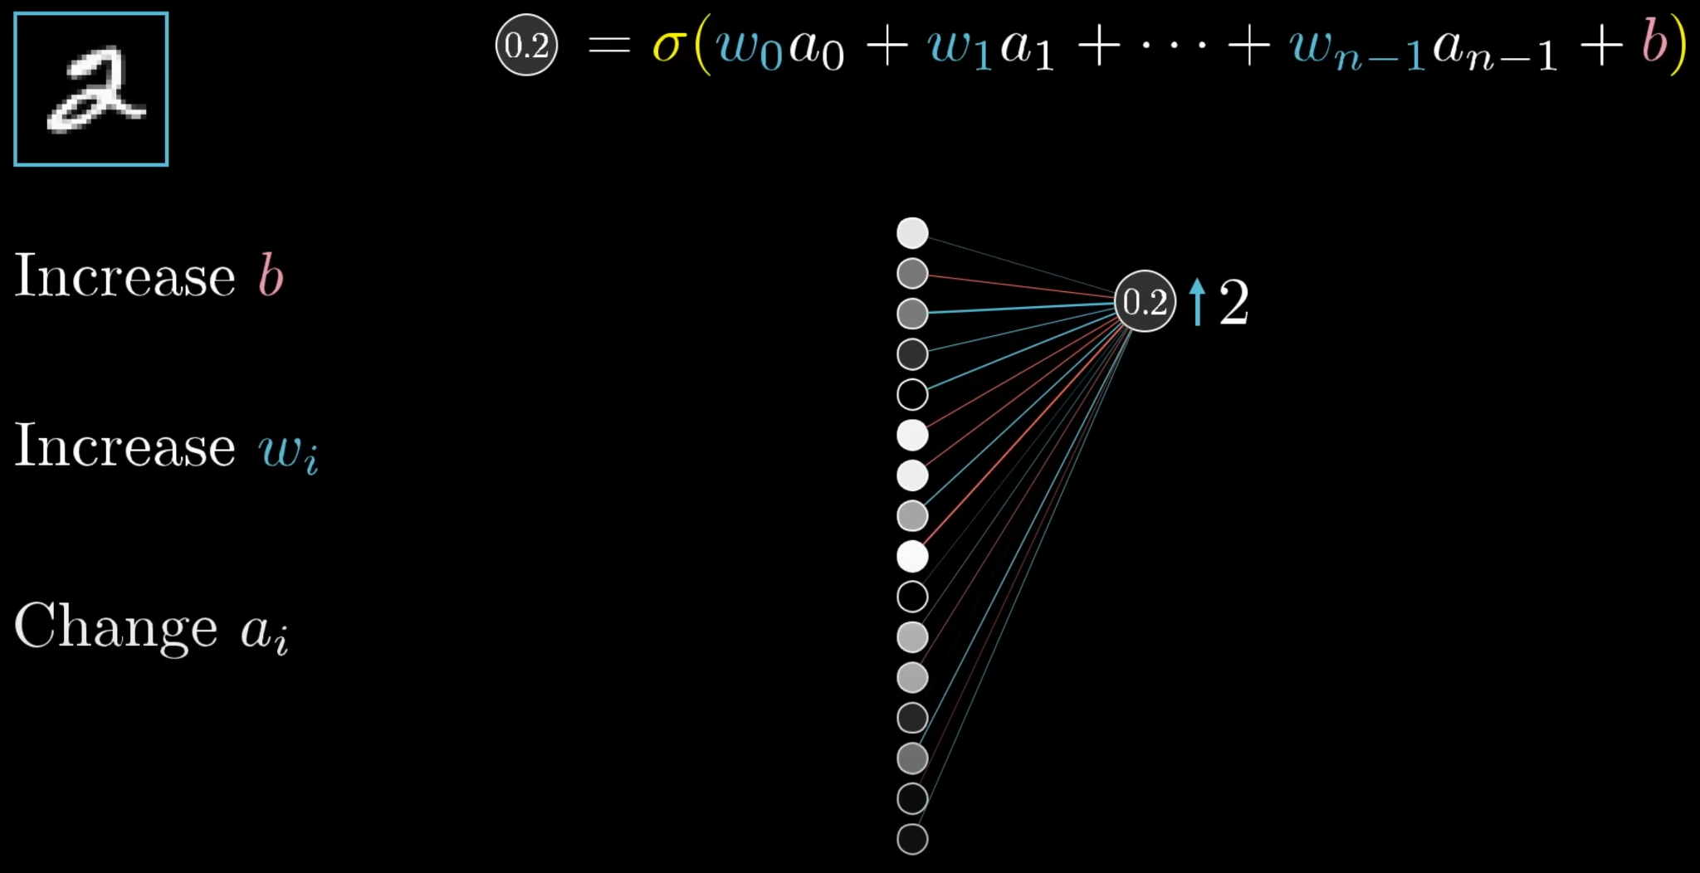
3Blue1Brown

Slide 23
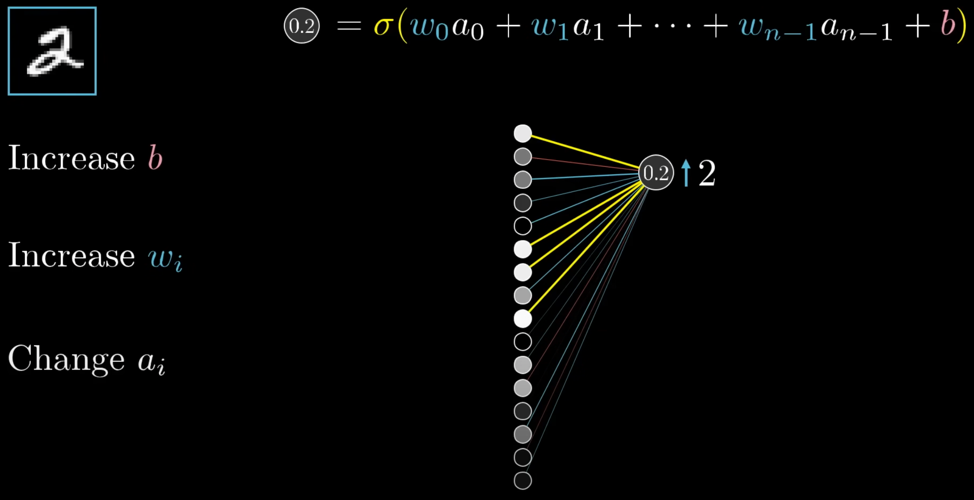
3Blue1Brown

Slide 24
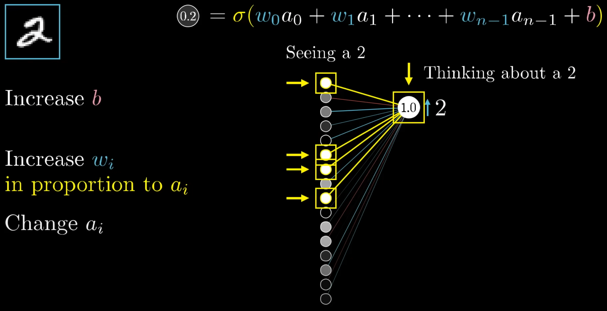
3Blue1Brown

Slide 25

3Blue1Brown

Slide 26
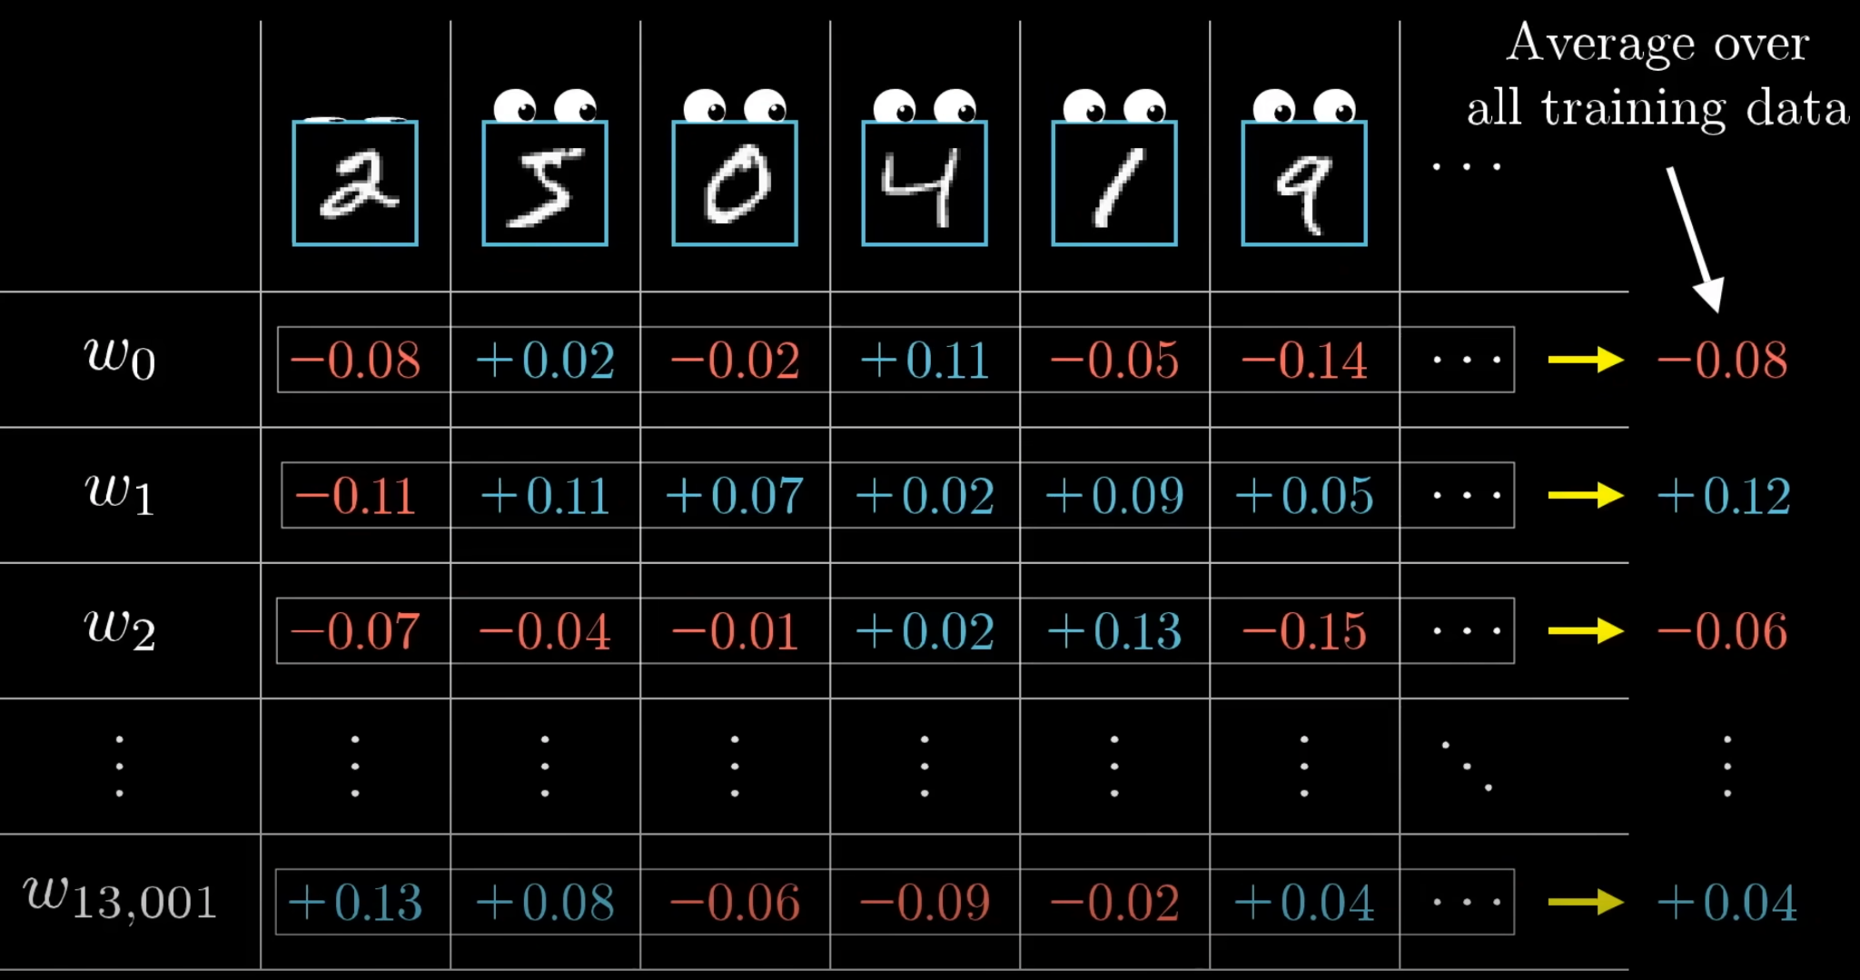
3Blue1Brown

Slide 27
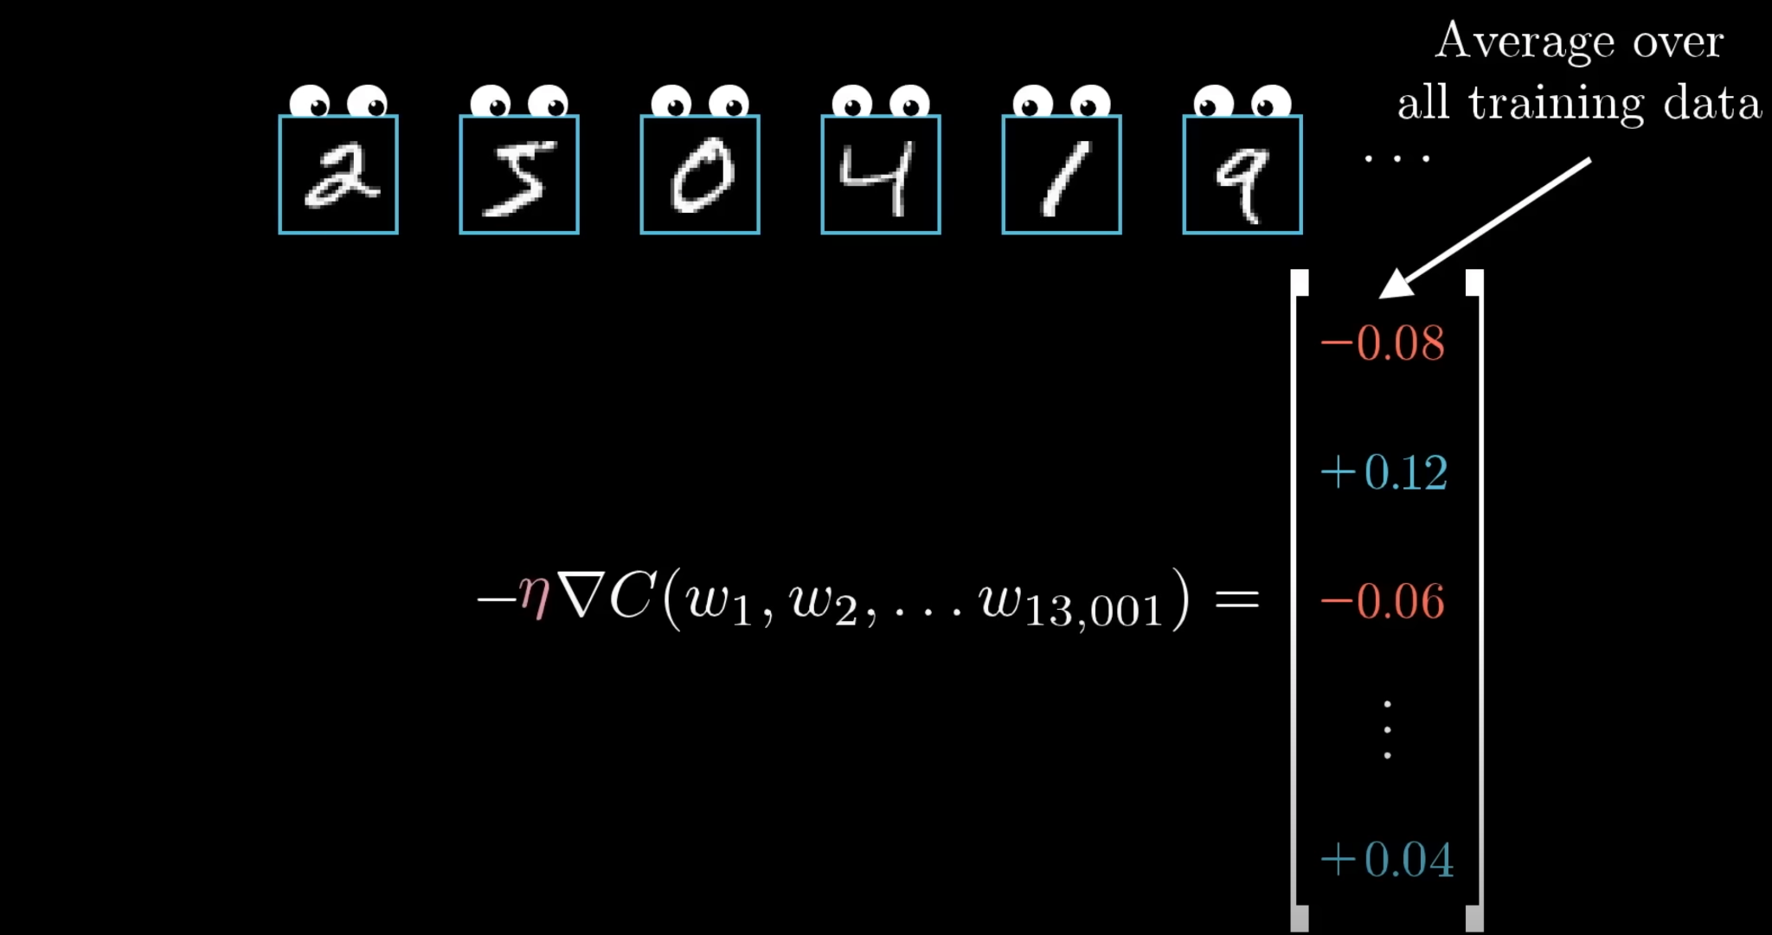
3Blue1Brown

Slide 28
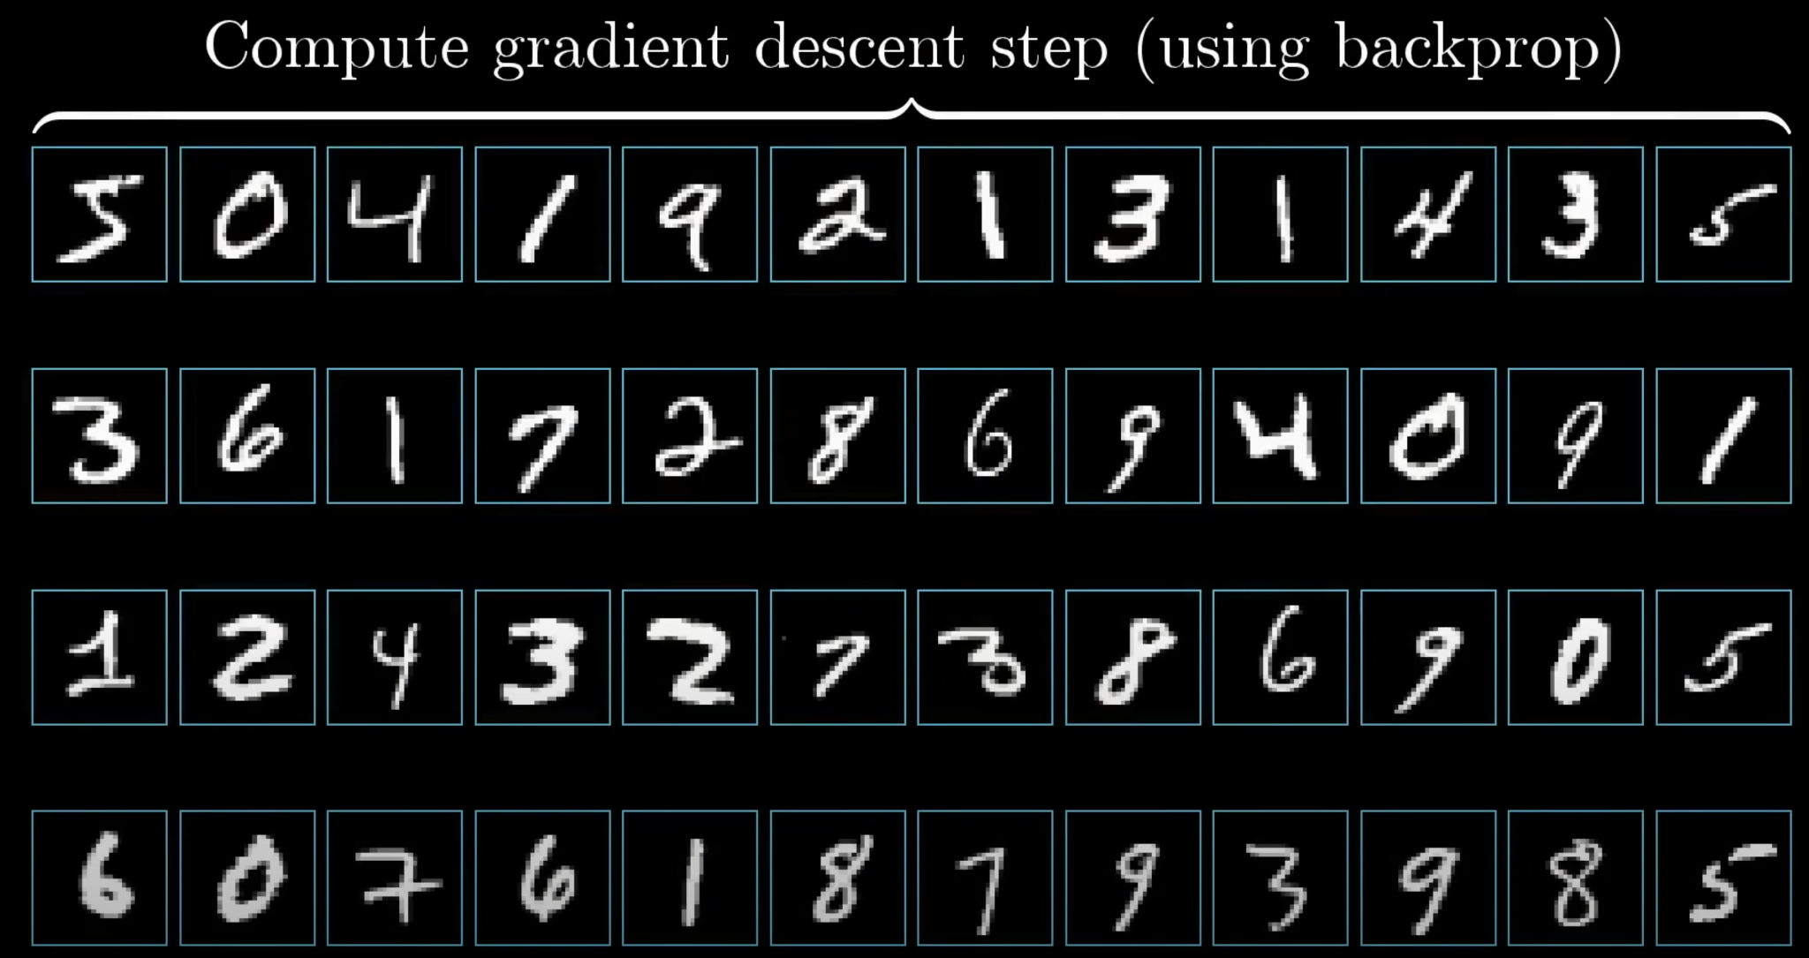
3Blue1Brown

Slide 29
Recap
Derivatives in computational graphs
Chain rule
Gradient formulas
Backprop intuition
Mini-batch technology
3Blue1Brown

Slide 30
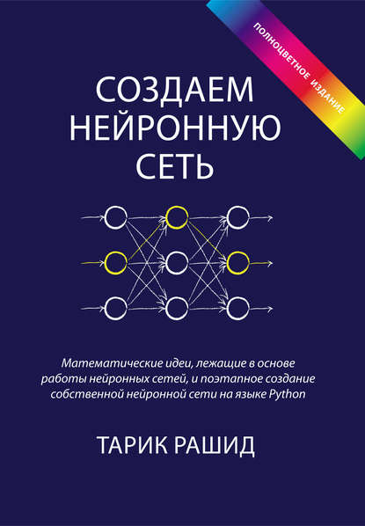
Future work
Тарик Рашид. “Создаем нейронную сеть”
Andrew Ng (classic ML)
Stanford CS229
Andrej Karpathy and Fei-Fei Li (deep learning)
CS231n Winter 2016
Радослав Нейчев (NLP)
Прикладное машинное обучение
3Blue1Brown

Slide 31
Future plan
CNN (maybe RNN repeat)
NLP course (~7-9 lectures)
CV course (~5-8 lectures)
Classic ML algorithms (~5-6 lectures)
3Blue1Brown

